Slide 1

Skills for Success with Microsoft Office 2016 Volume 1
by Margo Chaney Adkins, Catherine Hain, Lisa Hawkins, and Stephanie Murre Wolf
Access Chapter 1
Create Database Tables
Notes:
Skills for Success with Microsoft Office 2016 Volume 1

Slide 2
Skills
Create Databases
Create Tables in Datasheet View
Enter Data into Datasheets
Create Tables in Design View
Relate Tables
Notes:
The skills of this chapter are:
Create Databases
Create Tables in Datasheet View
Enter Data into Datasheets
Create Tables in Design View
Relate Tables
The skills continue on the next slide.

Slide 3
Skills (cont.)
6. Enter Data in Related Tables
7. Import Data into Tables
Filter and Sort Datasheets
Format Datasheets
Preview and Print Datasheets
Notes:
Additional skills include:
Enter Data in Related Tables
Import Data into Tables
Filter and Sort Datasheets
Format Datasheets
Preview and Print Datasheets

Slide 4
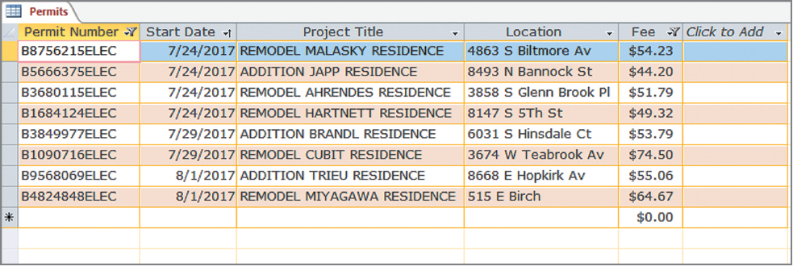

Outcome
Notes:
Using the skills in this chapter, you will create an Access table like this.

Slide 5
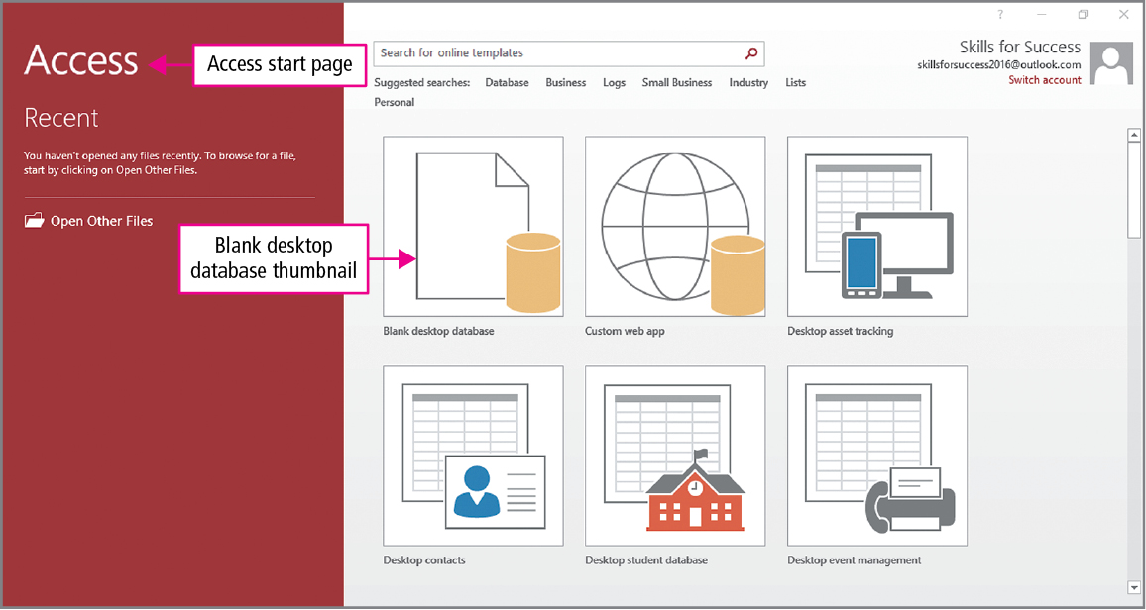
Skill 1: Create Databases
Notes:
Microsoft Office Access is an application used to store and organize data, and access and display that data as meaningful information.
An Access file can contain objects such as tables, forms, queries, and reports. In this first chapter, we will concentrate on working with tables, which are used to store our data.
When Access is opened, the Start screen displays, giving you several options:
Open a recent database
Create a new blank database
Create a database from a template
Before you create a new database, you assign a name and location for the database file.

Slide 6
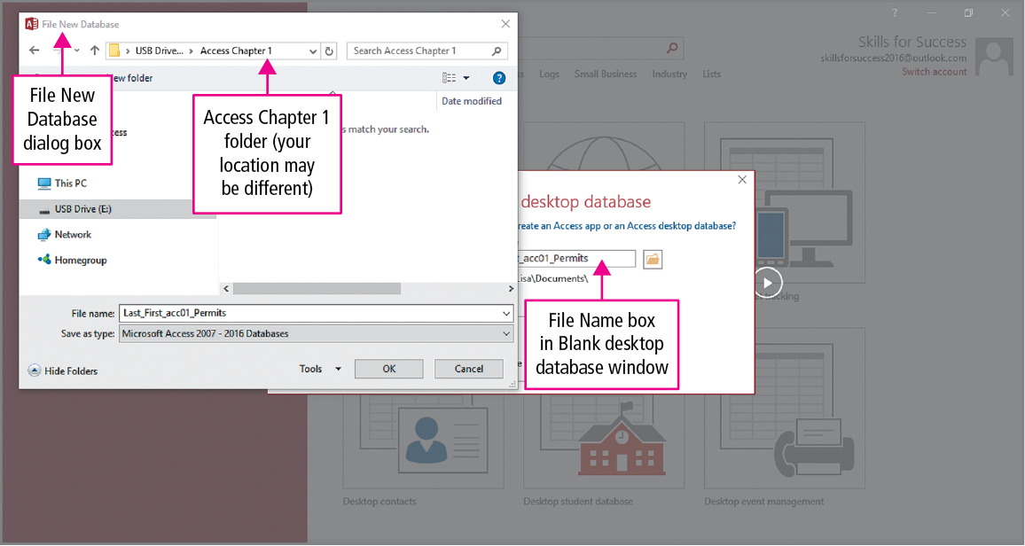
Skill 1: Create Databases (cont.)
Notes:
The Browse button is used to open the File New Database dialog box, and you use the File New Database dialog box to navigate to the location where you will be saving your work for this chapter.
For new files, you click New folder, and then type the folder name. Pressing Enter two times creates and opens the new folder.

Slide 7
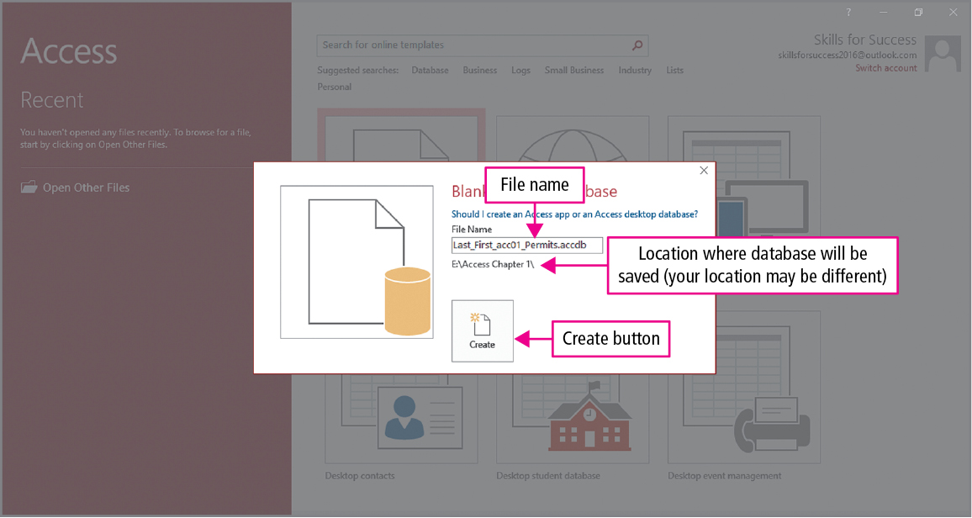
Skill 1: Create Databases (cont.)
Notes:
To accept the changes, click OK and close the File New Database dialog box, and then click the Create button to open a new database.

Slide 8
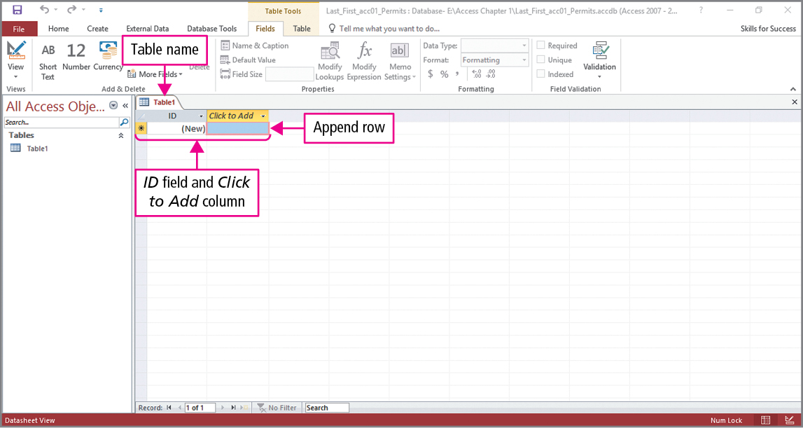
Skill 1: Create Databases (cont.)
Notes:
When a blank database is created, a new table is automatically started. The name Table1 is temporarily assigned to the table, and the first column—ID—is the name of a field.
Database tables store the data in rows and columns and are presented in datasheets. In a datasheet, each row is a record—a collection of related data such as the contact information for a person. Each column is a field that each record will store, such as an address or postal code.
Table1 is displayed in Datasheet view—a view that features the data but also has contextual tabs on the Ribbon, which allow changes to the table’s design. In Datasheet view, the last row of the table is the append row—the row where a new record is entered.

Slide 9
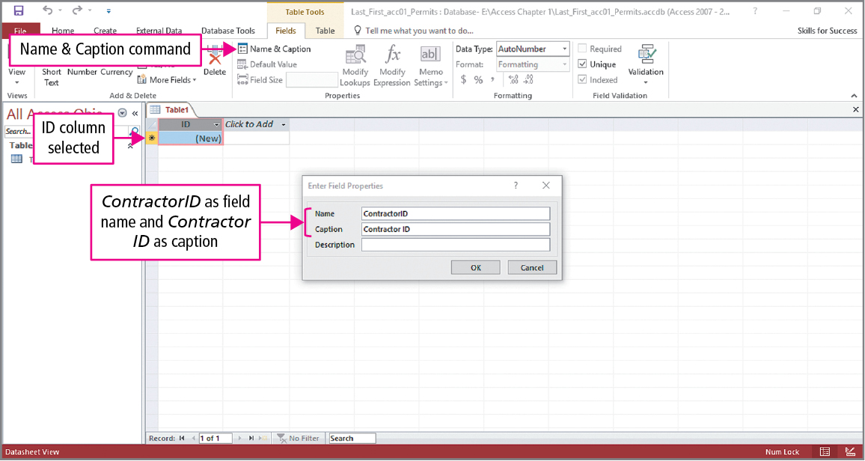
Skill 2: Create Tables in Datasheet View
Notes:
When designing a table, you add field names and properties. Data Type is a field property that specifies the type of information that a field will hold, for example—text, number, or date.
The Enter Field Properties dialog box is used to enter field information. In Table1, you would click the ID column header. On the Fields tab, in the Properties group, click Name & Caption, replace the Name box value with a field name, and in the Caption box, type a caption. The captions you enter determine what is displayed in datasheet, form, and reports.

Slide 10
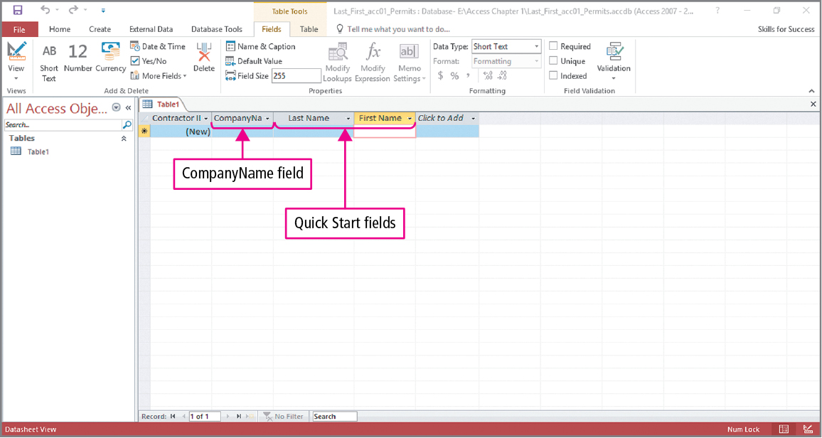
Skill 2: Create Tables in Datasheet View (cont.)
Notes:
In the second column, you would click Click to Add. Since this field will hold text, from the list of data types, click the Short Text data type, which stores up to 255 characters of text.
Name the field and then press Enter to move to the next column.
On the Fields tab, in the Add & Delete group, click the More Fields button. Near the bottom of the list of data types, click Name.
Quick Start fields are a set of fields that can be added with a single click. For example, the Name Quick Start data type inserts the LastName and FirstName fields, assigns the Text data type, and adds a caption with a space between the two words.

Slide 11
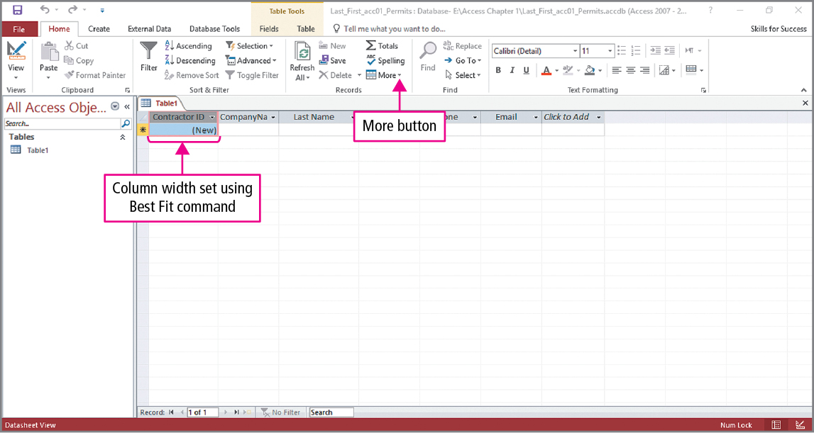
Skill 2: Create Tables in Datasheet View (cont.)
Notes:
Repeating the process used for the company name from the previous slide, two fields named Phone and Email both with the Short Text data type would be added.
Column widths can be changed to match the width of their contents. As data are added, the widths may need to be adjusted.
As an example, to change the width of the first column:
Click in the header row.
Click the HOME tab, and in the Records group, click More.
From the menu, click Field Width.
In the Column Width dialog box, click Best Fit.

Slide 12
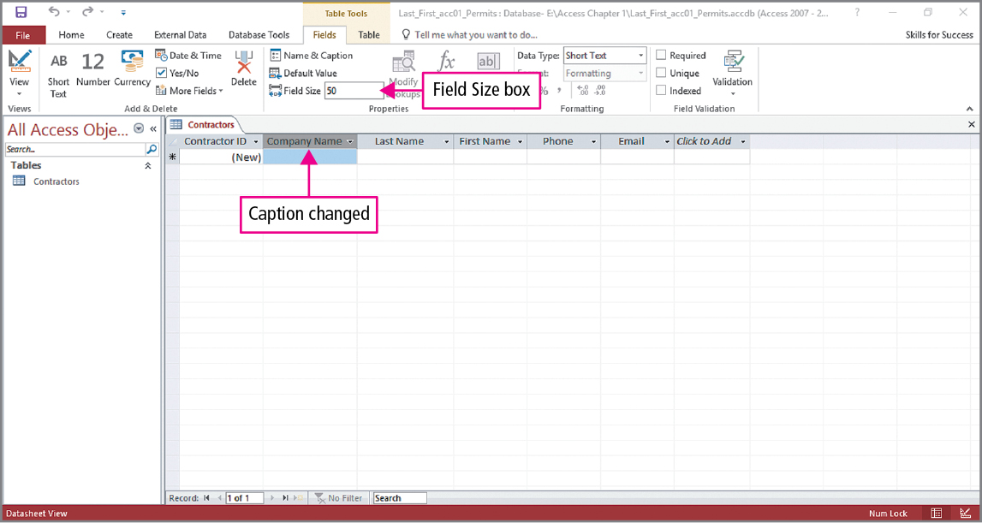
Skill 2: Create Tables in Datasheet View (cont.)
Notes:
To limit the number of characters, click the header row to select the column, and then click the FIELDS tab. In the Properties group, change the Field Size to the desired value. The field size limits the number of characters that can be typed into a text or number field. In the example shown in the slide, you can see the size has been changed to 50.
To enter or change a caption, click the field name, and in the Properties group, click Name & Caption. In the Enter Field Properties dialog, which we saw in a previous slide, make the desired change.
You should periodically save your work when you are designing your tables.

Slide 13
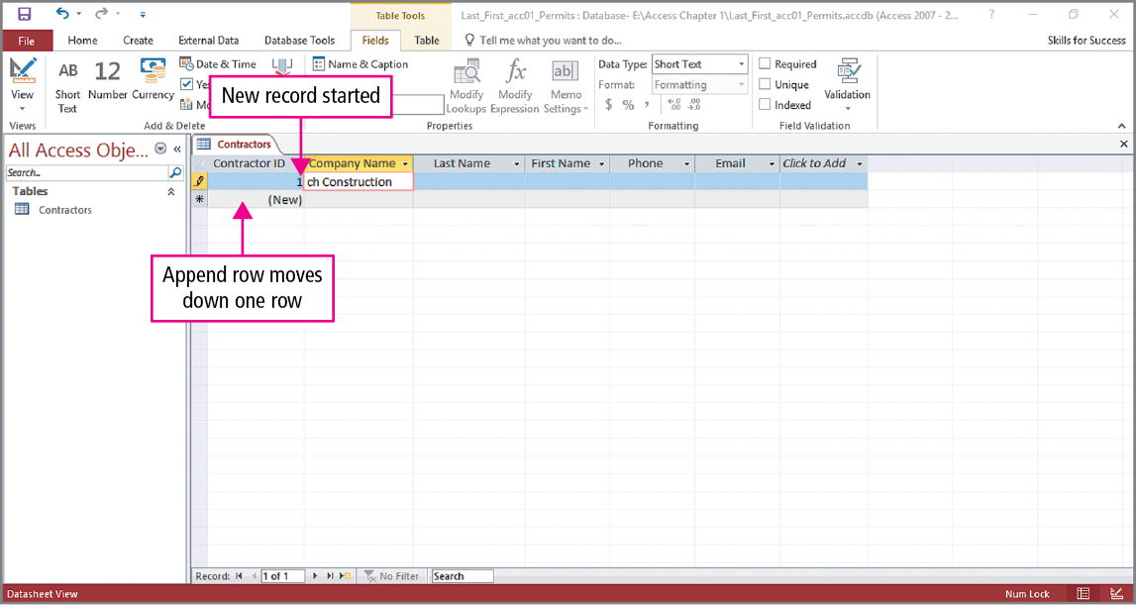
Skill 3: Enter Data into Datasheets
Notes:
When designing and building database tables, it is a good idea to enter some of the data that they will store. This allows the design to be tested and adjusted as needed.
Data is entered in the append row. In this example, you would click the first empty cell, type the name of a company Name, and press Enter.

Slide 14
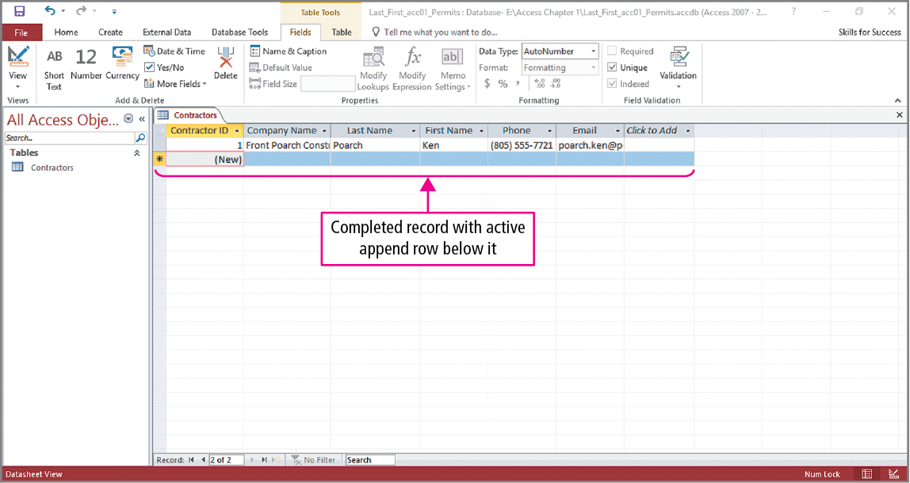
Skill 3: Enter Data into Datasheets (cont.)
Notes:
You would continue entering the data, pressing Enter after each entry. Pressing Enter after the last field moves the insertion point to the append row, and the data for the next record would be added.

Slide 15
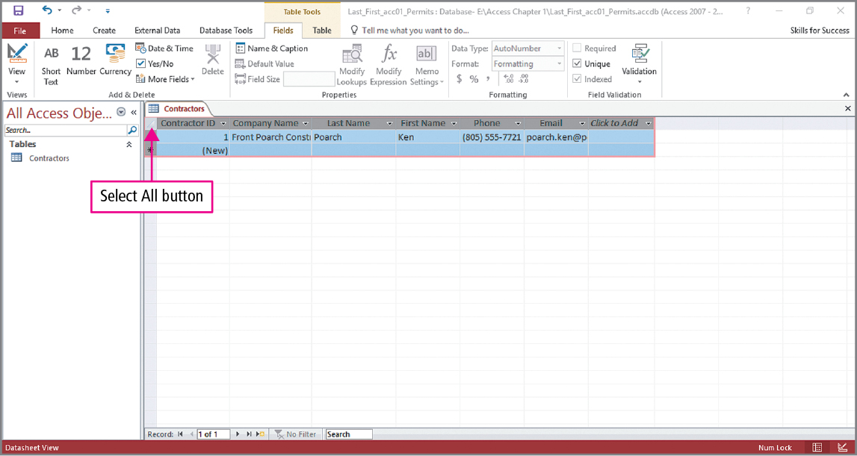
Skill 3: Enter Data into Datasheets (cont.)
Notes:
Once some data has been entered, the column widths may need to be changed. If adjustments are needed, click the Select All button and use the change width technique that was used in a previous slide. By selecting the entire datasheet, all widths are adjusted at the same time.
Your table should include a primary key. The primary key is a field that uniquely identifies each record in a table. In this example, ContracterID is the primary key. The data type for this field is AutoNumber. The AutoNumber data type automatically enters a unique, numeric value when a new record is created. Once an AutoNumber value has been assigned, it cannot be changed.

Slide 16
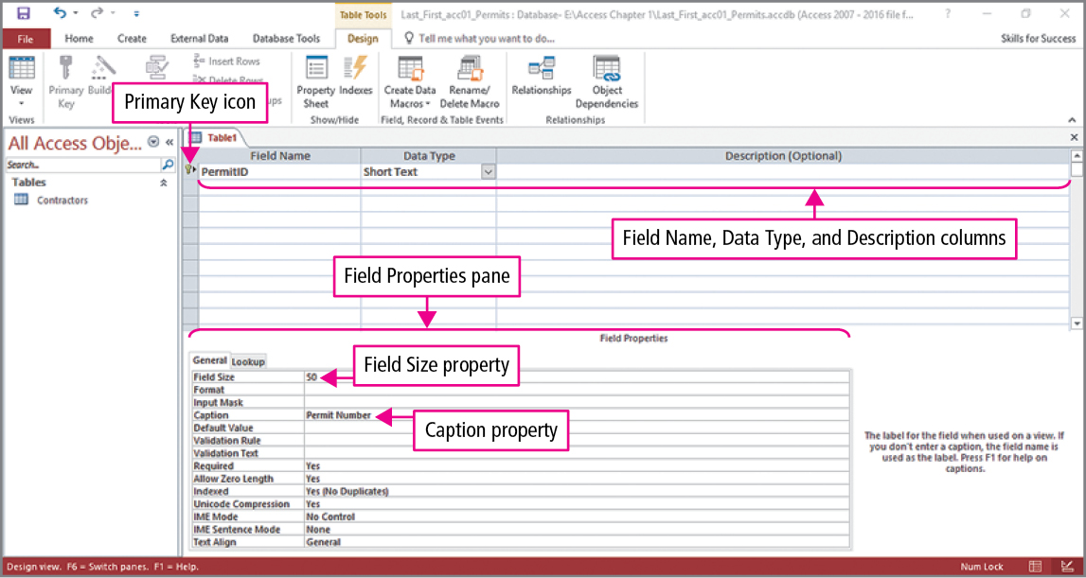
Skill 4: Create Tables in Design View
Notes:
Another method for creating a new table is to create it in Table Design view, which is a view that features table fields and their properties. When you are creating a table in Design view, the field name, data type, and description are entered in rows. All other field properties are entered in the Field Properties pane.

Slide 17
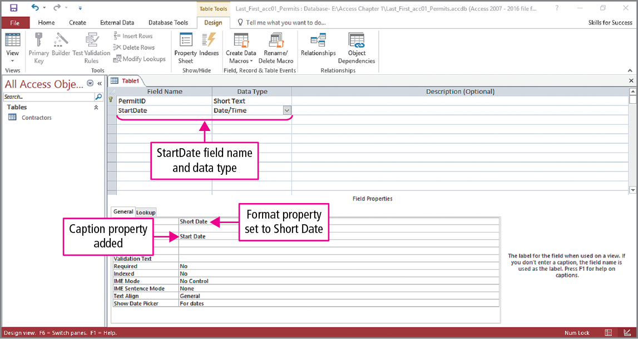
Skill 4: Create Tables in Design View (cont.)
Notes:
In this example, we see that a field named StartDate has been added with the Date/Time data type. The Date/Time data type stores serial numbers that are converted and formatted as dates or times.
Additional fields are created in a similar manner.

Slide 18
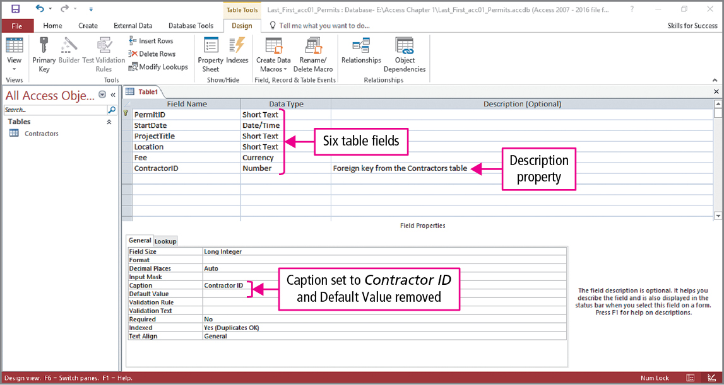
Skill 4: Create Tables in Design View (cont.)
Notes:
Looking at this slide, you can see there are now six fields. Notice the Fee field has a Currency data type, which stores numbers formatted as monetary values, and the ContractorID has a Number type, which stores numeric values.
The ContractorID field was used as a foreign key. A foreign key is a field that is used to relate records in a second related table. The foreign key field is often the second table’s primary key. In this example, the ContractorID is the primary key of the Contractors table and will be used to join this table to the Contractors table.

Slide 19
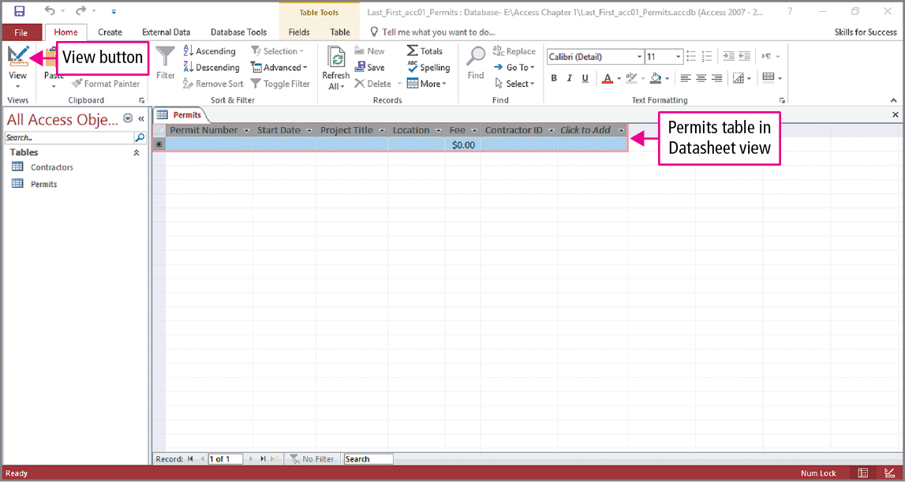
Skill 4: Create Tables in Design View (cont.)
Notes:
To save and name the new table, you click Save. To view the table in Datasheet view, click the View button. Looking at the slide, we see that the table has been named Permits, and note the $0.00 in currency field. When finished viewing the table, you would click Close.

Slide 20
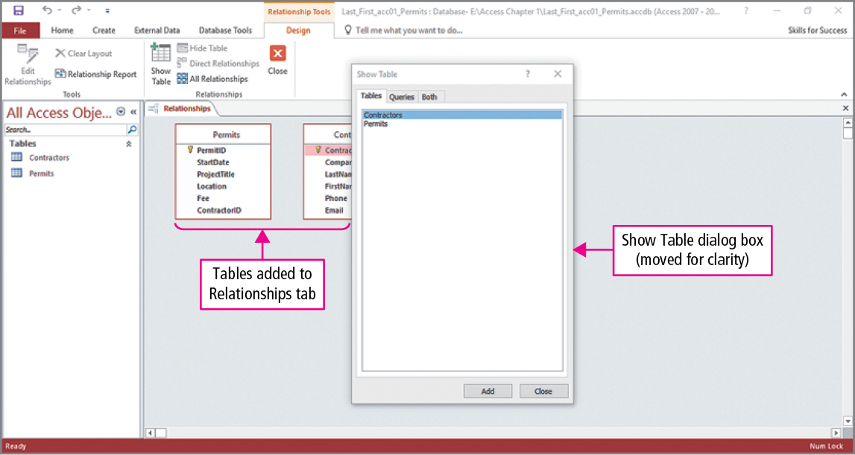
Skill 5: Relate Tables
Notes:
You can relate records in two tables by placing the same field in both tables and then creating a relationship between them. This is done by clicking the Database Tools tab, and in the Relationships group, clicking the
Relationships button, which displays the Relationships tab and Show Table dialog box.
To add a table to the Relationship pane, you can double-click its name in the dialog box. As seen in the slide, our two tables have been to the Relationships tab.

Slide 21
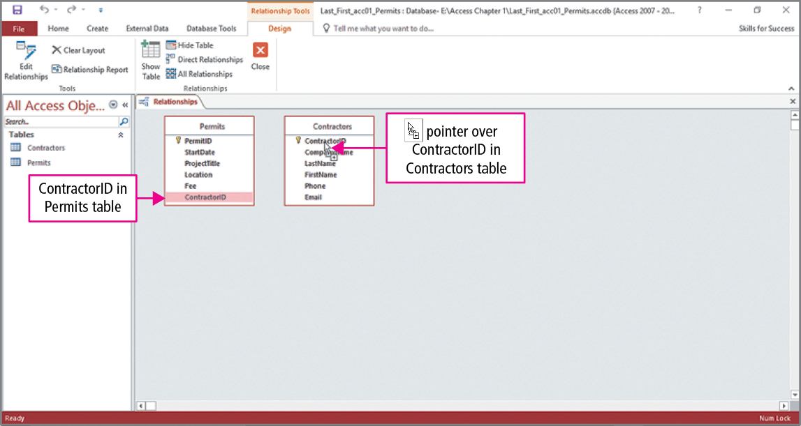
Skill 5: Relate Tables (cont.)
Notes:
To create a relation, you select a field in the first table, drag the field to the matching field in the second table, and release the mouse button. As seen in the slide, the ContractorID field has been dragged from the Permits table to the ContractorID in the Contractors table.

Slide 22
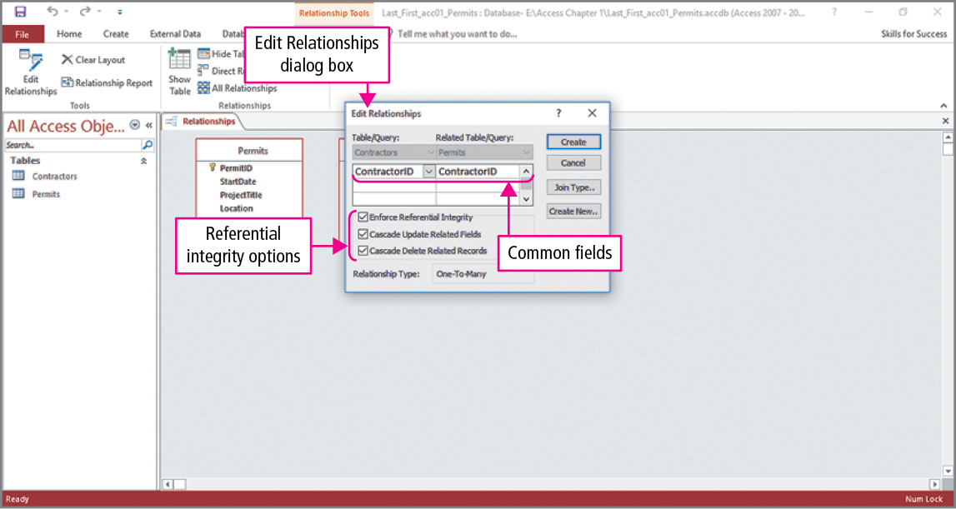
Skill 5: Relate Tables (cont.)
Notes:
The Edit Relationships dialog box opens, and in it you would select the Enforce Referential Integrity, Cascade Update Related Fields, and Cascade Delete Related Records check boxes.
Tables are typically joined in a one-to-many relationship—a relationship in which a record in the first table can have many associated records in the second table.
Referential integrity is a rule that keeps related values synchronized, and this option must be selected to create a one-to-many relationship.
With a cascading update, if the primary key values are edited in a table, all the related records in the other table will update accordingly.
With a cascading delete, if a record is deleted on the one side of the relationship, then all the related records on the many side are deleted.

Slide 23
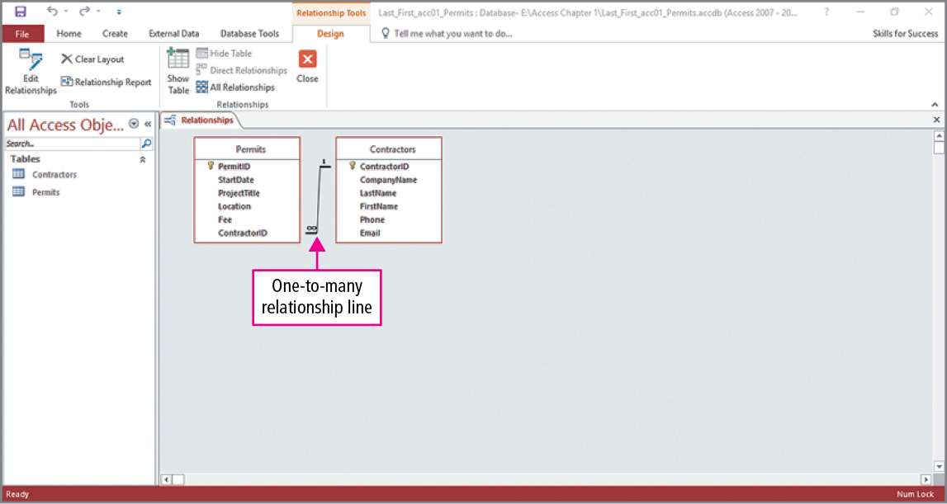
Skill 5: Relate Tables (cont.)
Notes:
Clicking Create in the Edit Relationships dialog box closes the dialog box and establishes the relationship shown in the slide. Notice the join line indicates that a contractor can have more that one permit. When finished viewing the relationship, you would click Close.

Slide 24
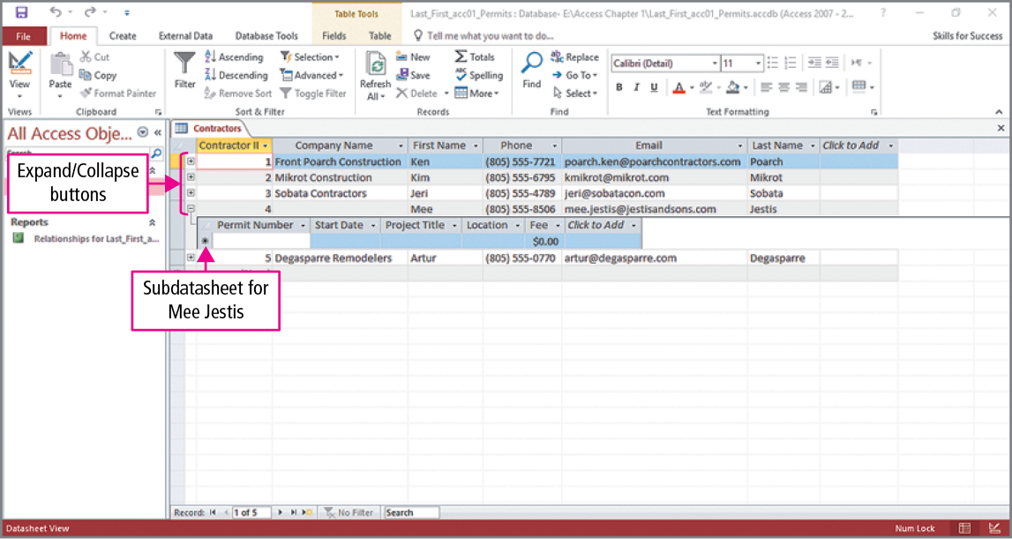
Skill 6: Enter Data in Related Tables
Notes:
When a table is on the one side of a relationship, a subdatasheet is available. A subdatasheet displays related records from another table by matching the values in the field that relates the two tables. For example, all the permits issued to each contractor can be listed by matching the ContractorID value assigned to that permit.
Looking at the slide, the Expand/Collapse button for the fourth record has been clicked, and we see that no permits have been issued to that contractor.

Slide 25
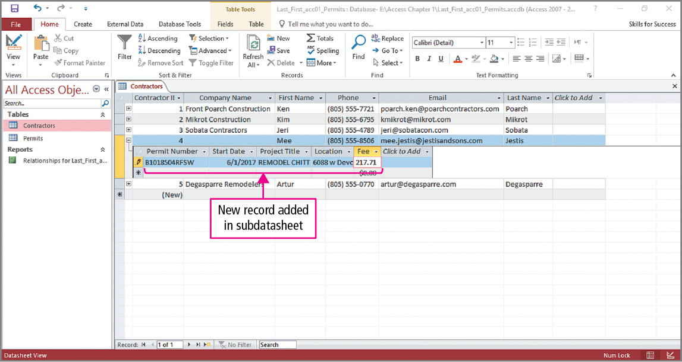
Skill 6: Enter Data in Related Tables (cont.)
Notes:
A new permit can be issued by clicking in the append row and entering the data in the subdatasheet. We see that the information for a new permit has been entered, and additional permits for this contractor can be entered in the same manner. When finished, click Close.

Slide 26
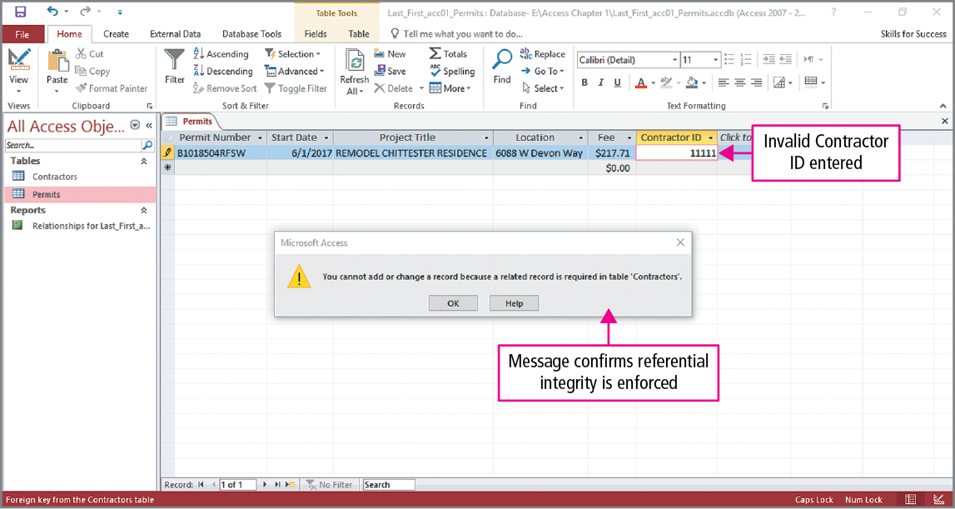
Skill 6: Enter Data in Related Tables (cont.)
Notes:
Open the Permits datasheet by double-clicking Permits under tables in the Navigation Pane. We are going to test referential integrity by trying to change the ContractorID for the first record. Typing a different value, 11111, results in the warning shown in the slide. As you can see, referential integrity is working correctly, and a ContractorID that that does not exist in the related Contractors table cannot be entered.

Slide 27
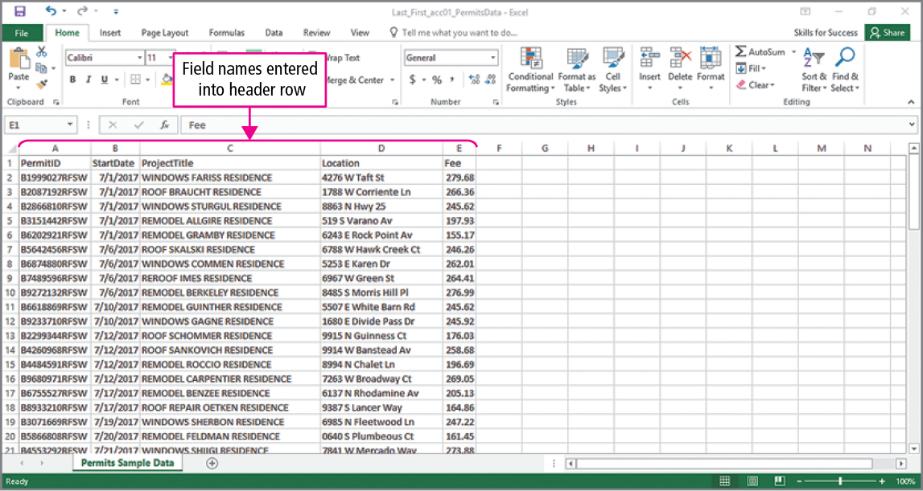
Skill 7: Import Data into Tables
Notes:
Excel tables that are arranged as datasheets can be imported into Access tables. This slide shows an Excel table, in which column names have been typed. When importing data from Excel, it is best practice to insert the table’s field names in the spreadsheet’s header row. Once this has been done, the Excel file would be saved and Excel closed.

Slide 28
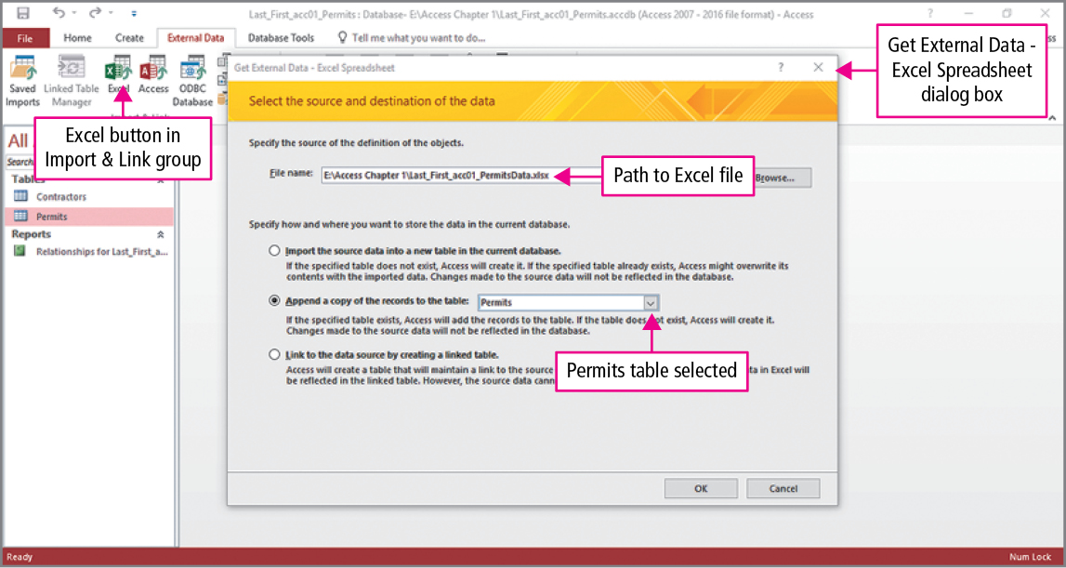
Skill 7: Import Data into Tables (cont.)
Notes:
Returning to Access, we will now import the data from the spreadsheet. Click Excel in the Import & Link group on the External Data tab to open the Get External Data - Excel Spreadsheet dialog box. Click Browse, navigate to the location of the Excel file, and select it. Click the Append a copy of the records to the table option, click the arrow, select the Permits table, and click OK.

Slide 29
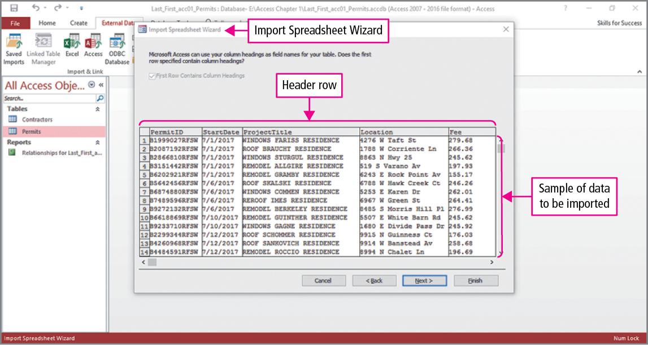
Skill 7: Import Data into Tables (cont.)
Notes:
To open the Import Spreadsheet Wizard dialog box, click OK, and after the desired worksheet is selected, a sample of worksheet data is displayed. You should verify that the names in the header row match the field names. Notice that First Row Contains Column Heading is checked.

Slide 30
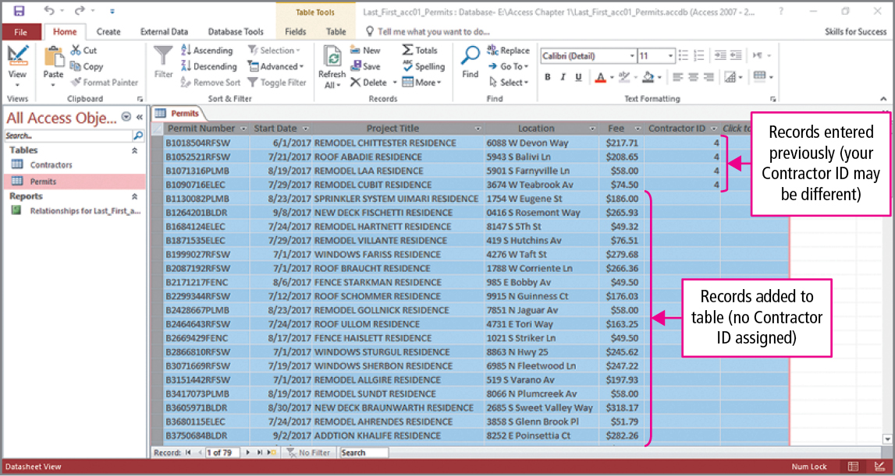
Skill 7: Import Data into Tables (cont.)
Notes:
Complete the wizard steps by verifying that the Import to Table box displays the text Permits, and that the I would like a wizard check box is cleared, and then click Finish. When the Save Import Steps screen appears, verify that the Save import steps check box is cleared and click Close.
When the Permits table is opened in Datasheet view, you see the Excel data has been added to the table. In the scenario in the text, the Contractor ID is blank because these permits were issued to homeowners who are doing their own work.

Slide 31
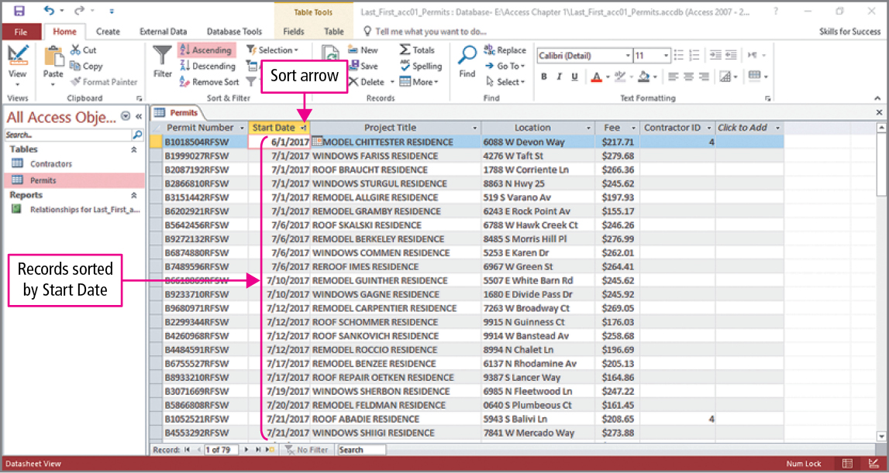
Skill 8: Filter and Sort Datasheets
Notes:
Access datasheets can be sorted and filtered to present the information in more meaningful and useful ways. Presently, the table is displayed in order of the permit numbers, and it will be changed so that the table is sorted by the start date from the earliest starting date to the latest starting date.
Click anywhere in the Start Date column, then click the Ascending button in the Sort & Filter group on the HOME tab. Note the sort arrow in the start date column indicating that the table is sorted in ascending order by the date.

Slide 32
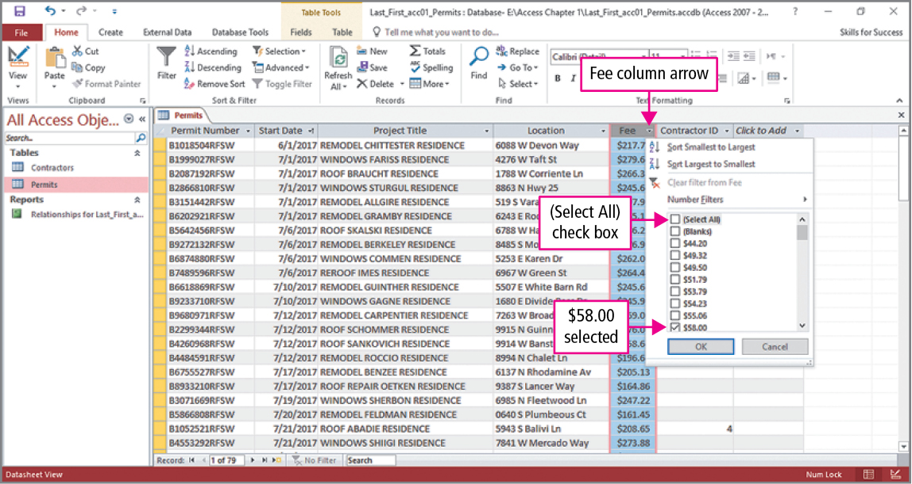
Skill 8: Filter and Sort Datasheets (cont.)
Notes:
In this slide, we are going to apply a filter so only records having certain fee amount are displayed. The example shown in the slide will only show fees in the amount of $58.00. This is done by clicking the Fee arrow and, in the Filter menu that displays, clearing the (Select All) check box to deselect all the fees, and then selecting the $58.00 check box. To remove this filter, click the Fee arrow and click Clear filter from Fee. The filtering of fees is not limited to just matching an existing fee. To display all records for which fees are less than a specified amount, you would click the Fee arrow, point to Number Filters, and click Less Than. In the Custom Filter dialog box, type the desired amount, which in the text is $75.00.

Slide 33
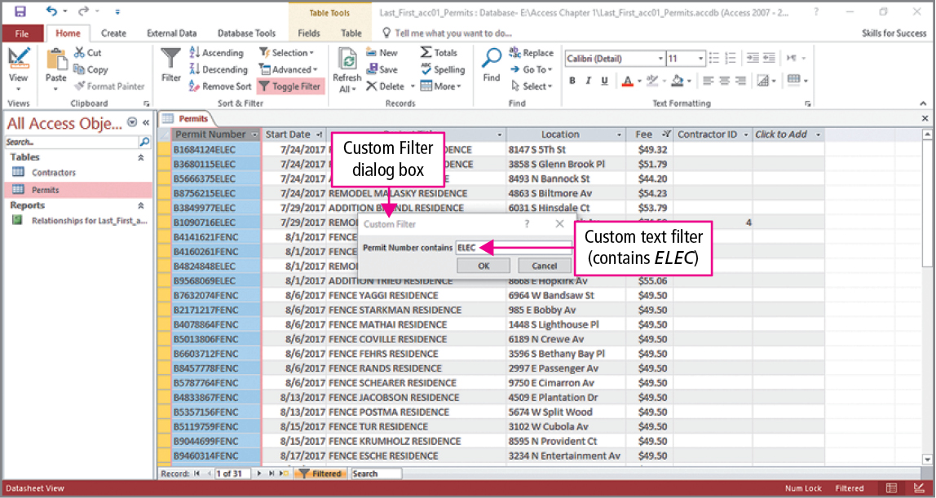
Skill 8: Filter and Sort Datasheets (cont.)
Notes:
In this slide, we will see how to filter the table and display permits that include any electrical work. Click the Permit Number arrow. From the Filter menu, point to Text Filters, and click Contains. In the Custom Filter dialog box, type ELEC.

Slide 34
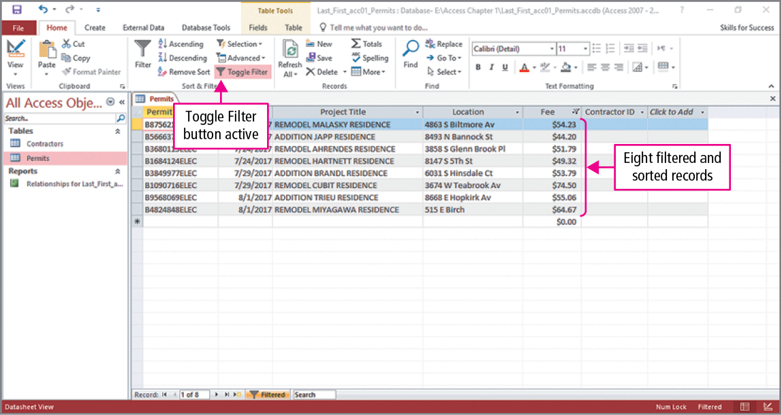
Skill 8: Filter and Sort Datasheets (cont.)
Notes:
In our final slide, we see eight records. Looking at the permits, we see only permits involving electrical work are listed. Looking at the fees, we see all the fees are less than $75.00. And looking at the dates, we see that the records are displayed in date order.
Note: The sort order and filter created in a datasheet are saved as part of the table’s design. When the table is reopened, it is still sorted in the specified order, but the filter is not applied. To reapply the filter, click the Toggle Filter button.

Slide 35
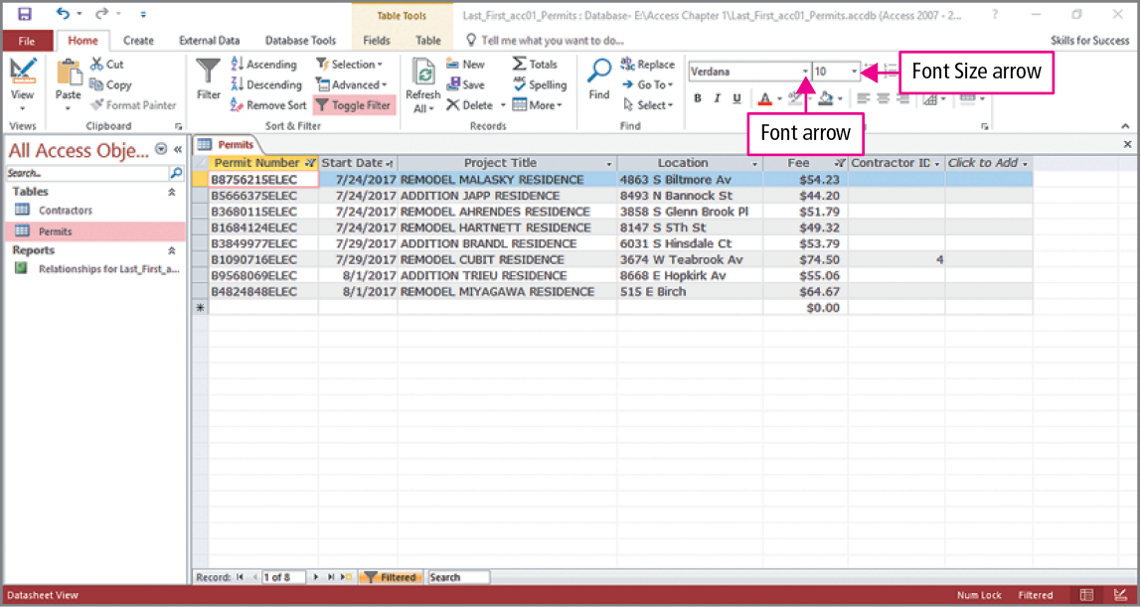
Skill 9: Format Datasheets
Notes:
Datasheets can be formatted to make the data easier to read. We begin by changing the font and font size. As seen in the slide, both changes are made in the Text Formatting group where the font has been changed to Verdana and font size has been changed to 10. Note: Any changes to the font and font size are applied to the entire datasheet.

Slide 36
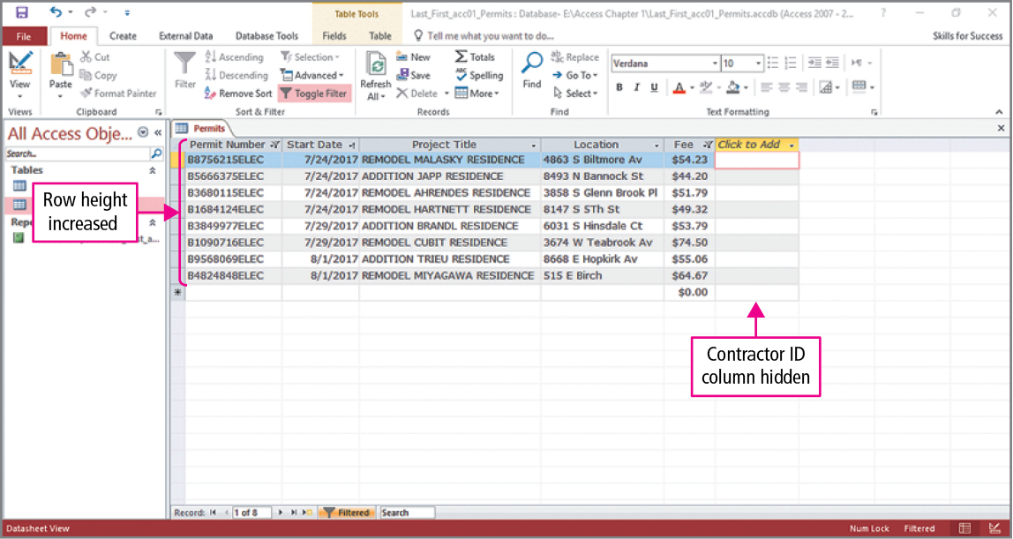
Skill 9: Format Datasheets (cont.)
Notes:
In this slide, the row heights will be adjusted and a column will be hidden. To adjust the row heights, click More in the Records group on the Home tab and click Row Height to display the Row Height dialog box. Replace the existing value with the desired value. To hide a column, click anywhere in the column to select it, click More in the Records group on the Home tab, and select Hide Fields from the menu. As seen in the slide the row heights have been increased, and the Contractor ID field no longer shows.

Slide 37
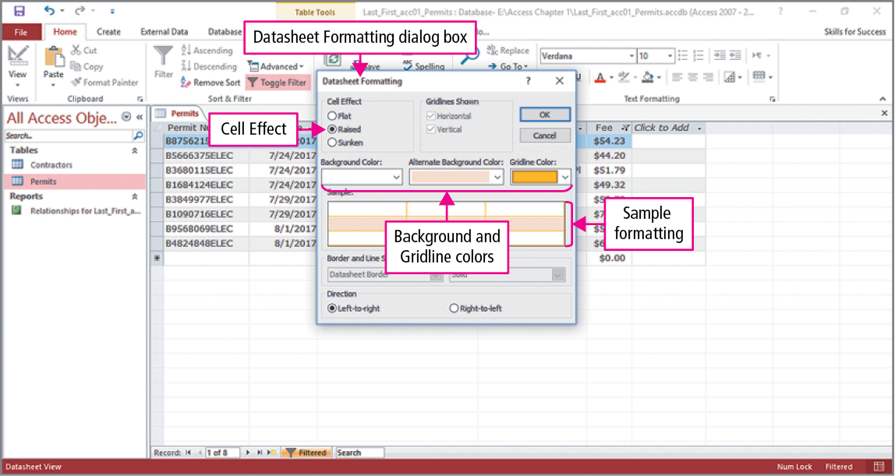
Skill 9: Format Datasheets (cont.)
Notes:
In this slide, coloring and an effect will be applied to the datasheet. Click the Datasheet Formatting Dialog Box Launcher in the Text Formatting group to open the Datasheet Formatting dialog box. In the dialog box, select the desired cell effect, background color, alternate background color, and theme color. As seen in the slide, a sample of these selections is displayed.

Slide 38
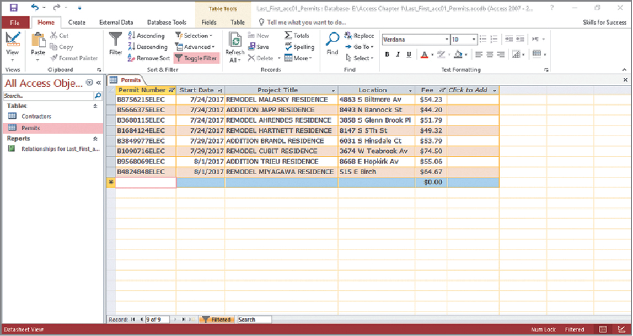
Skill 9: Format Datasheets (cont.)
Notes:
Once the desired changes have been made, click OK to close the dialog box and apply the changes. This slide shows the results of the selected changes.

Slide 39
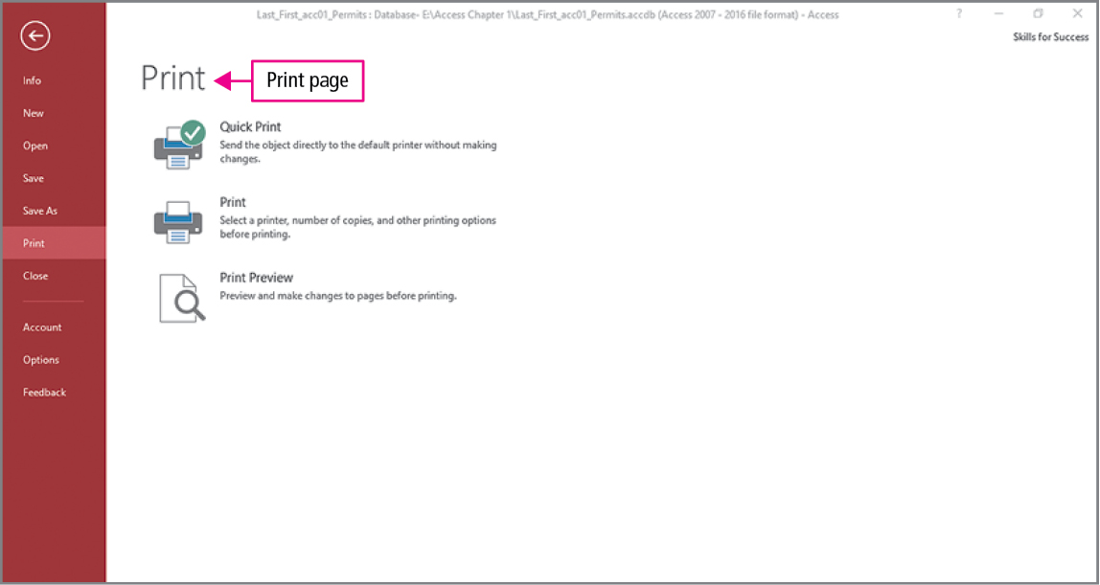
Skill 10: Preview and Print Datasheets
Notes:
Before printing, it is a good idea to preview the printed page(s) and make any necessary adjustments. With the table opened in Datasheet view, click Print on the File tab. As seen in the slide, there are three print options: the Quick Print option prints the object directly, the Print option opens the Print dialog box so you can select a different printer or different print options, and the Print Preview option opens a preview of the table with ribbon commands that you can use to make adjustments to the object you are printing.

Slide 40
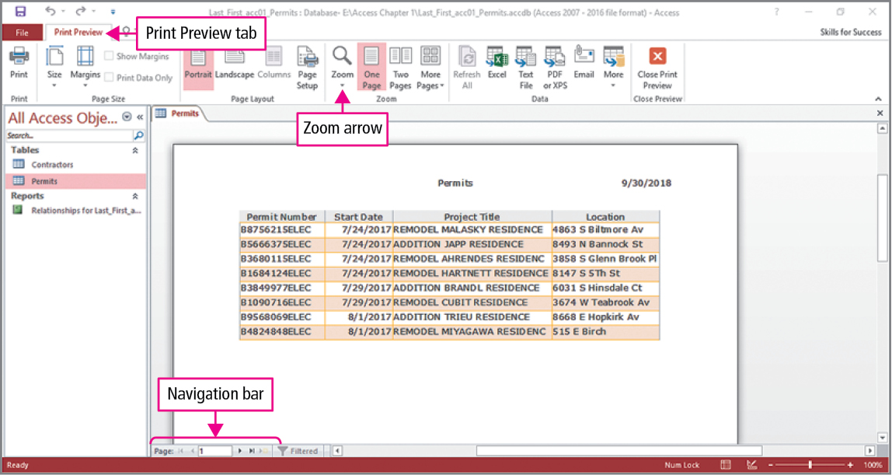
Skill 10: Preview and Print Datasheets (cont.)
Notes:
You can use the tools in the Zoom group to zoom in and out and the buttons on the Navigation bar to view other pages. Notice the last column representing the fee field does not appear.

Slide 41
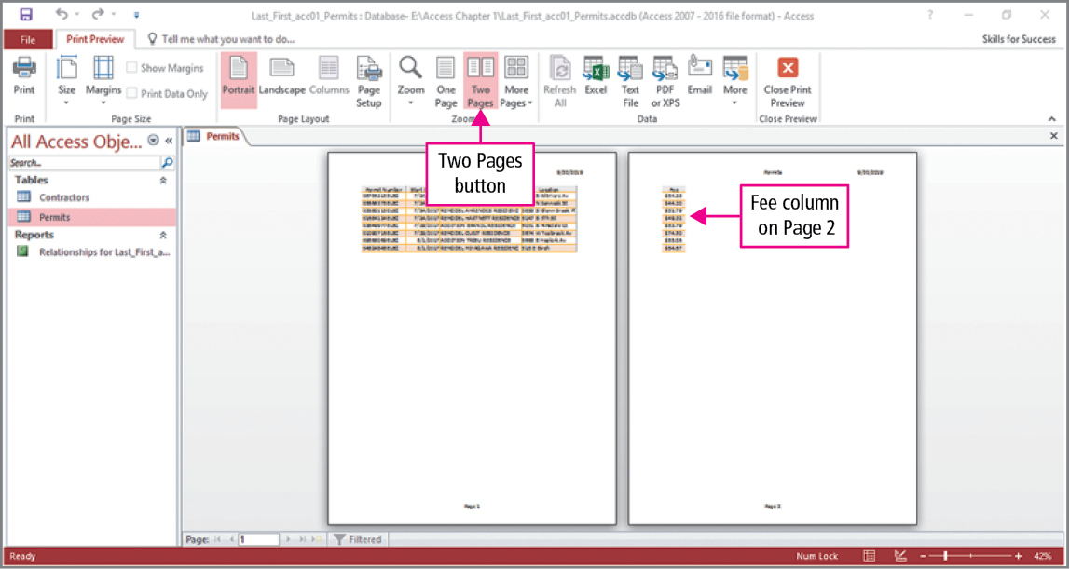
Skill 10: Preview and Print Datasheets (cont.)
Notes:
Changing to the two-page view, we see that the last column will print on a second page. One way to correct this is to change the orientation of the page from Portrait to Landscape. The terms are easy to remember; just think of a painting or photograph and their meanings are obvious.

Slide 42
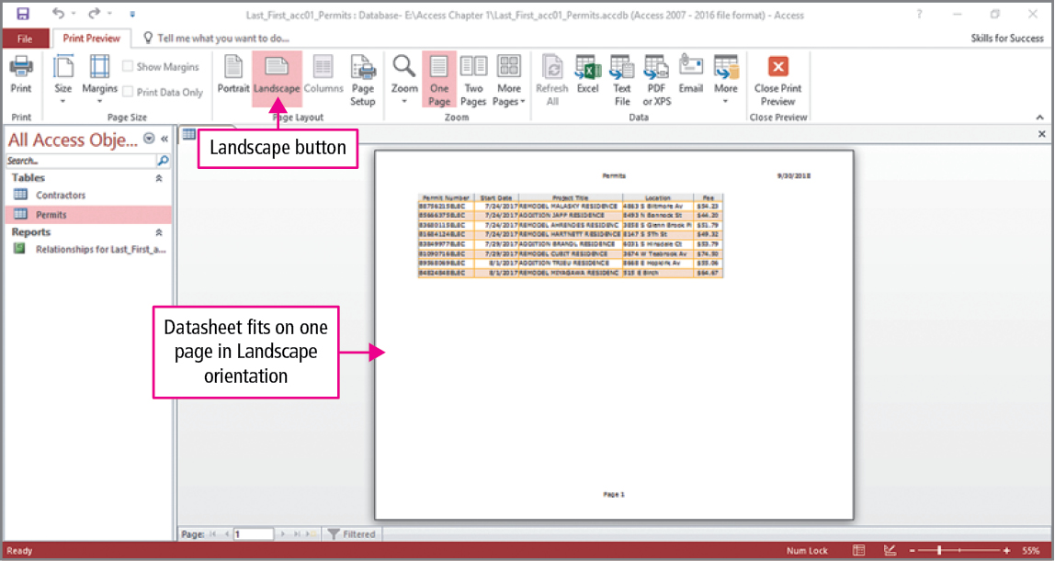
Skill 10: Preview and Print Datasheets (cont.)
Notes:
Clicking Landscape and changing back to one-page view, you can see that the entire table will be printed on a single page. If your instructor requires a printed copy, you would click the Print button in the upper left corner of the ribbon.

Slide 43
More Skills For Success
You will now practice the following additional skills:
Compact and Repair Databases
Work with the Long Text Data Type
Work with the Attachment Data Type
Work with the Hyperlink and Yes/No Data Types
Notes:
You will now practice the following additional skills:
Compact and Repair Databases
Work with the Long Text Data Type
Work with the Attachment Data Type
Work with the Hyperlink and Yes/No Data Types

Slide 44
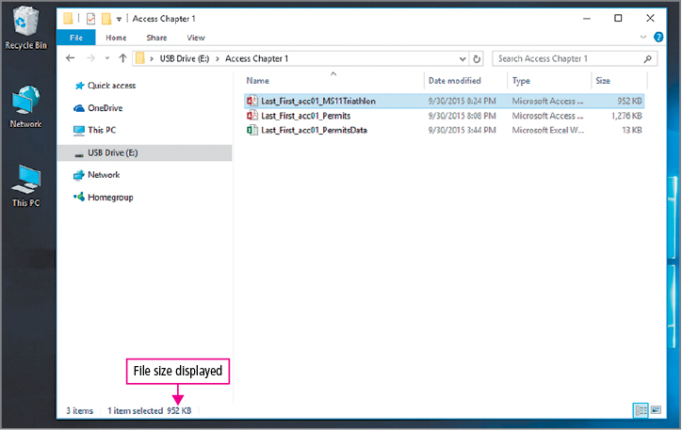
More Skills 11: Compact and Repair Databases
Notes:
The Compact and Repair Databases process rebuilds database files so data and database objects are stored more efficiently. It also decreases the size of a database file and improves database performance.
Periodically using the Compact and Repair tool can improve the performance of the databases.
Open File Explorer, navigate to and place the pointer over the desired database file to display its file size in a ScreenTip.

Slide 45
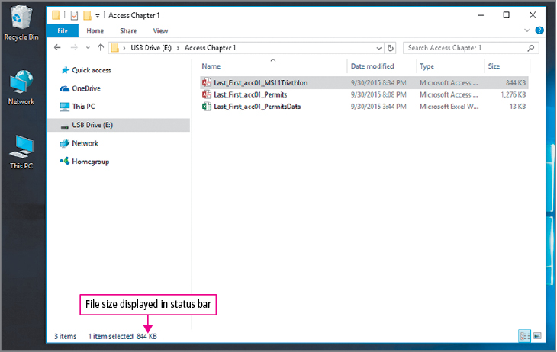
More Skills 11: Compact and Repair Databases (cont.)
Notes:
To open the file in Access, double-click the file name. As database objects such as tables, queries, or forms are deleted, the size of the database files does not decrease. To recover any deleted space, click the File tab, and on the Info page, click Compact & Repair Database. Close the database and return to File Explorer to see that the size of the database file decreased.

Slide 46
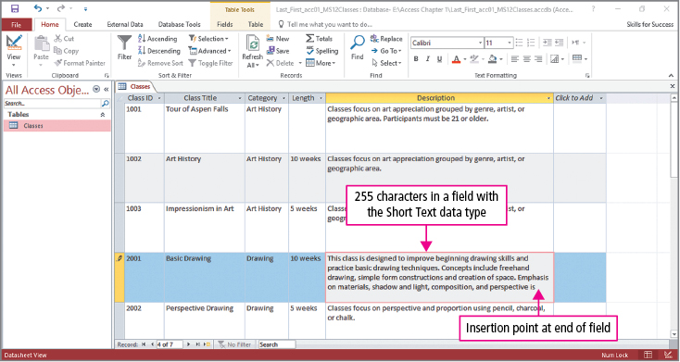
More Skills 12: Work with the Long Text Data Type
Notes:
Short Text data type can store up to 255 characters per record, but what happens if a record requires more characters? The Long Text data type can store up to 65,535 characters in each record. The next example shows a database that requires the use of the Long Text data type. The Description field already contains text, and when additional text is added, the insertion point stops moving when the 255 character limit is reached.

Slide 47
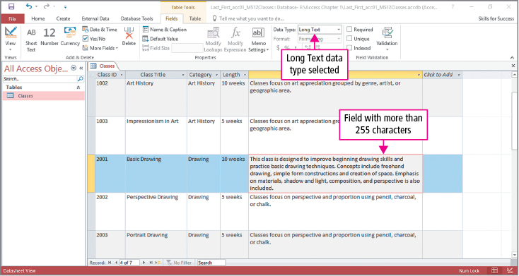
More Skills 12: Work with the Long Text Data Type (cont.)
Notes:
The remedy is simple; change the field from Short Text to Long Text. Click the Data Type arrow in the Formatting group on the Fields tab, and select Long Text from the menu. With the data type changed, additional text can be added to the Description field. Be careful when going the other way. Changing from Long Text to Short Text will permanently remove all characters beyond the 255 character limit.

Slide 48
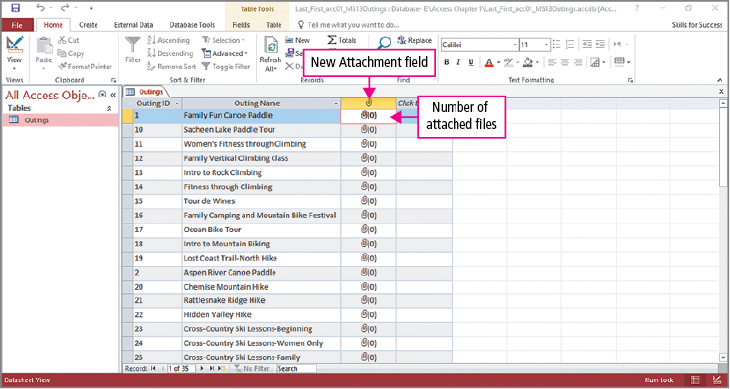
More Skills 13: Work with the Attachment Data Type
Notes:
The Attachment data type is used to store files such as Word documents or digital photo files. Note: Attached files can then be opened and viewed in the application in which they were created. Using the example in the text, we will attach image files to the table. This is done by clicking the Click to Add arrow in the last column and selecting Attachment from the menu. A new field is inserted into the table, where the number in the parentheses indicates the number of files currently attached to each record—0 in this case, since no files have been attached.

Slide 49
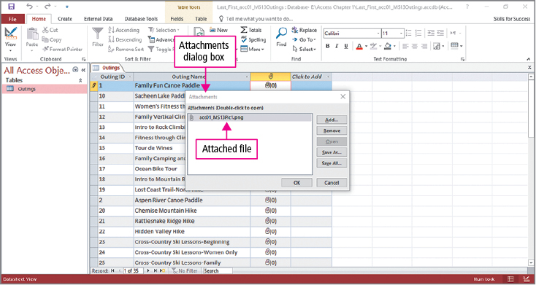
More Skills 13: Work with the Attachment Data Type (cont.)
Notes:
To attach an image to a record, double-click the Paper Clip icon to open the Attachments dialog box. In the dialog box, click Add; in the Choose File dialog box, navigate to and select the desired image file, as shown here, and then click Open. The Attachments dialog box lists all files currently attached to the Family Fun Canoe Paddle record.

Slide 50
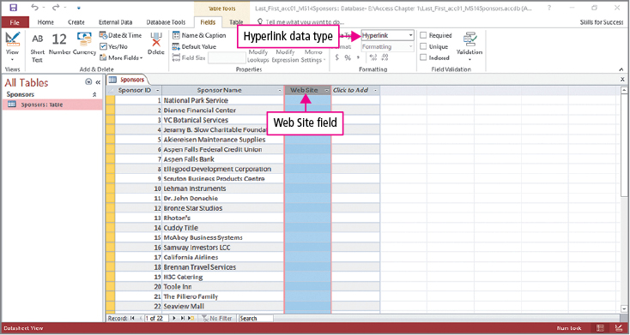
More Skills 14: Work with the Hyperlink and Yes/No Data Types
Notes:
The Hyperlink data type stores links to websites or files located on your computer. In datasheets, forms, and reports, field values display as hyperlinks.
The Yes/No data type stores variables that can have one of two possible values—for example, yes or no, or true or false.
Using the example in the text, we will add a field that contains hyperlinks. This is done by clicking the Click to Add arrow in the last column and selecting Hyperlink from the menu. A new field is inserted into the table, which will be named Web Site.

Slide 51
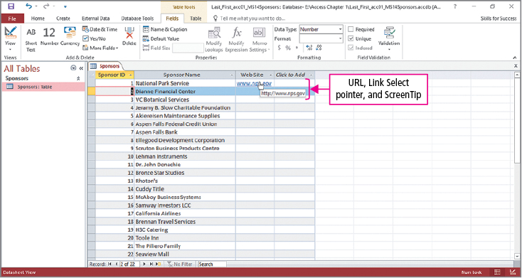
More Skills 14: Work with the Hyperlink and Yes/No Data Types (cont.)
Notes:
As you have already learned, click the record in which the data will be entered, and type the link. As you can see, the link is active, and clicking it will open the website in your browser.

Slide 52
Summary
Purpose of the database
Plan table organization
Creating tables and table properties
Creating table relationships
Notes:
Access is an application used to store, organize, and display data as meaningful information.
When creating a database, first determine the purpose of the database, then plan how to organize the data into tables.
When a table is created, properties are assigned that match the intended data that will be entered into the database table.
After creating tables, relationships between them are established and the data is entered.

Slide 53
Questions
Notes:
As you complete this introduction to Access, be sure you ask questions. You want to understand the concepts so that you can continue to build on them in future chapters.

Slide 54

Copyright
All rights reserved. No part of this publication may be reproduced, stored in a retrieval system, or transmitted, in any form or by any means, electronic, mechanical, photocopying, recording, or otherwise, without the prior written permission of the publisher. Printed in the United States of America.

